Slide 1

EPAD for Practice assessors and Supervisors
Robert Barrowcliff
Caroline Carter
Updated 05/02/24

Slide 2
Overview
Time management
Fields to complete and assessed elements
Verification process
Deadlines
Practice Supervisor & Practice Assessor roles
Sharing EPAD

Slide 3
Time management
Plan and book all meetings at Initial Interview
Initial Interview Day One
Final Interview First day of the final week
Mid-Point Interview 50% through placement
Key dates:

Slide 4
Practice Supervisor & Practice Assessor roles
Practice Assessor:
Medicines Management
Professional Values
Episode of Care
Mid-Point Interview and Assessment / Grade
Final Interview and Assessment / Grade
Ongoing Achievement Record (OAR)

Slide 5
Practice Supervisor & Practice Assessor roles
Practice Supervisor:
Orientation
Initial Interview
Assessment of Proficiencies
Worked Hours
Absence Hours
Feed forward to the Assessor for Mid-Point & Final Interviews via Record of Communication / Working with Others or face to face.

Slide 6
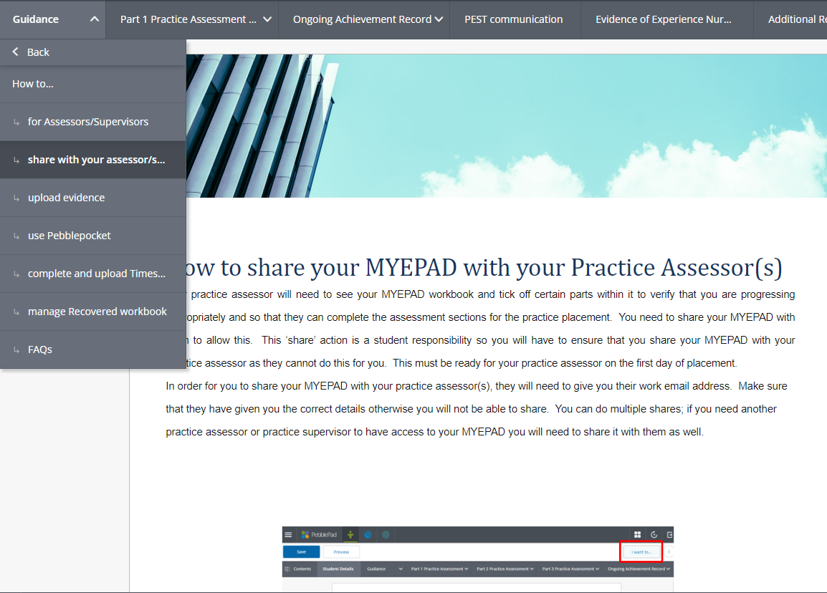
Sharing the EPAD
Sharing EPAD is the student’s responsibility
Ideally shared with the Practice Assessor before the first day of placement
Will require the Practice Assessor & Practice Supervisor work email addresses
Scroll down the page and follow the instructions
The EPAD team can be contacted in the case of any technical issues via: https://forms.office.com/Pages/ResponsePage.aspx?id=0aJeJGVDJkeAWmMeuT2TqlScLwqKq8tJmTvsCpFiGT5UNEJJVjMwUlo2V1Y2Wks1Tkg4OFhUOE5GTiQlQCN0PWcu

Slide 7
All Fields Must Be Completed
Placement Details
Orientation
Initial Interview
Professional Values and Reflection
Mid Point Interview
Mid Point Assessment
Assessment of Proficiencies
Episode of Care
Medicines Management and Reflection
Worked hours
Final Assessment and Interview
Ongoing Achievement Record (OAR)

Slide 8
First Day of Placement
Orientation
Initial Interview
Placement Details
Elements to complete:

Slide 9
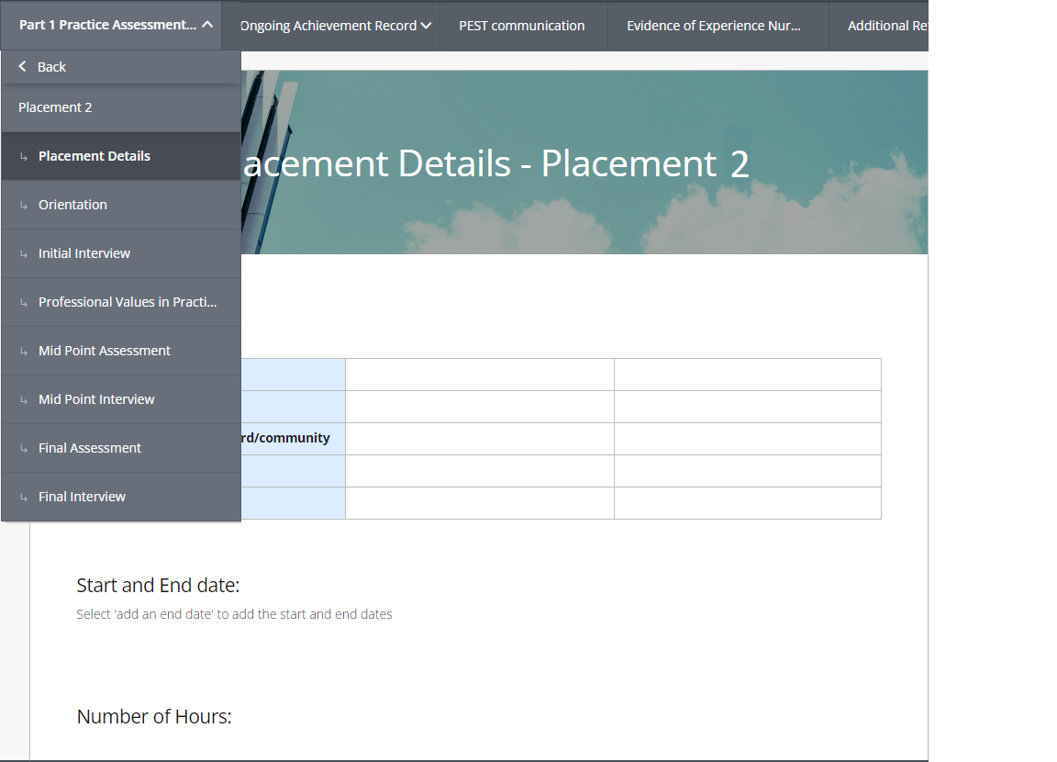
Placement Details
Complete the text boxes
Scroll down the page and complete as necessary

Slide 10
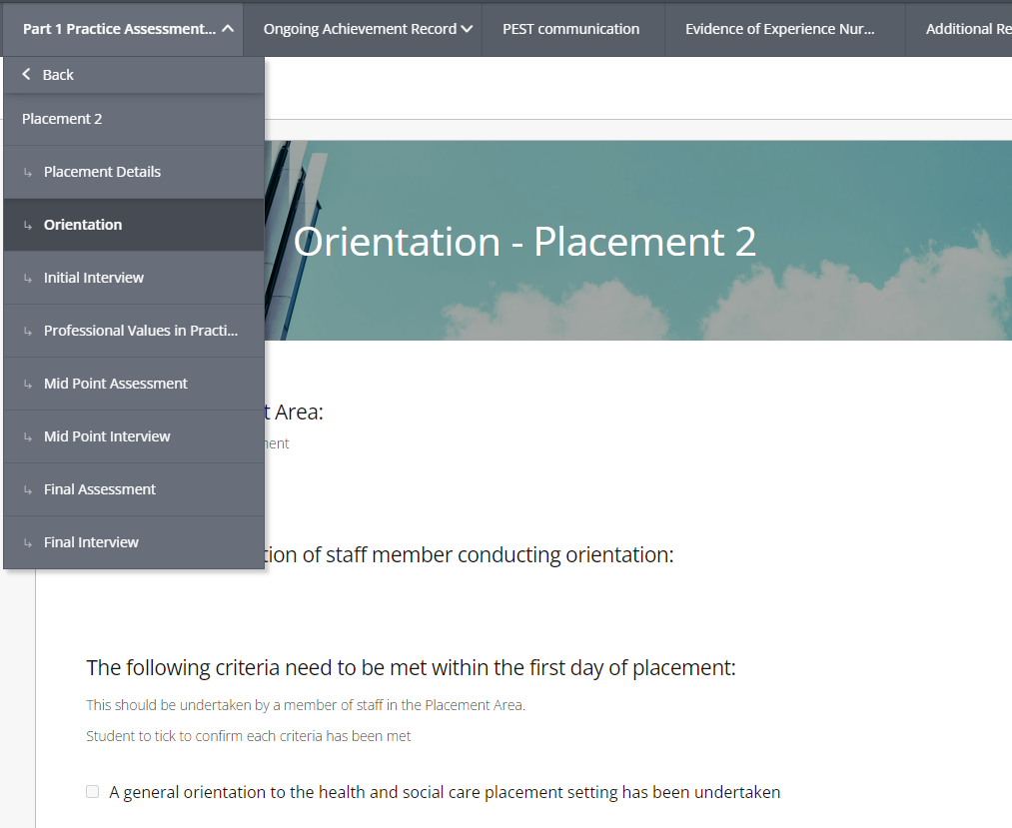
Orientation
Complete the text boxes
Scroll down the page and complete as necessary
Check the following boxes:
  Student Declaration
  Practice Supervisor/Assessor Verification

Slide 11
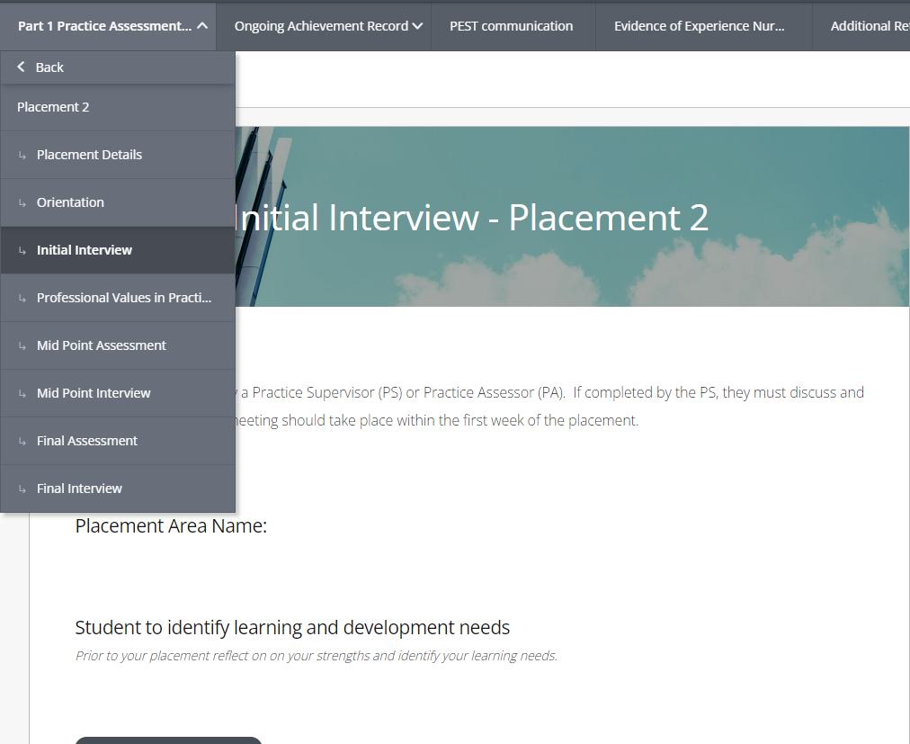
Initial Interview
Complete the text boxes
Scroll down the page and complete as necessary
Check the following boxes:
  Student agrees to the learning plan
  Practice Supervisor agrees to the learning plan
  Practice Assessor agrees to the learning plan

Slide 12
Mid-Point Interview
Mid-Point Interview
Elements to complete:
Mid-Point Assessment
The student should also be working on:
Professional Values
Assessment of Proficiencies
Episode of Care
Medicines Management
Maintaining your worked hours and documenting any absences

Slide 13
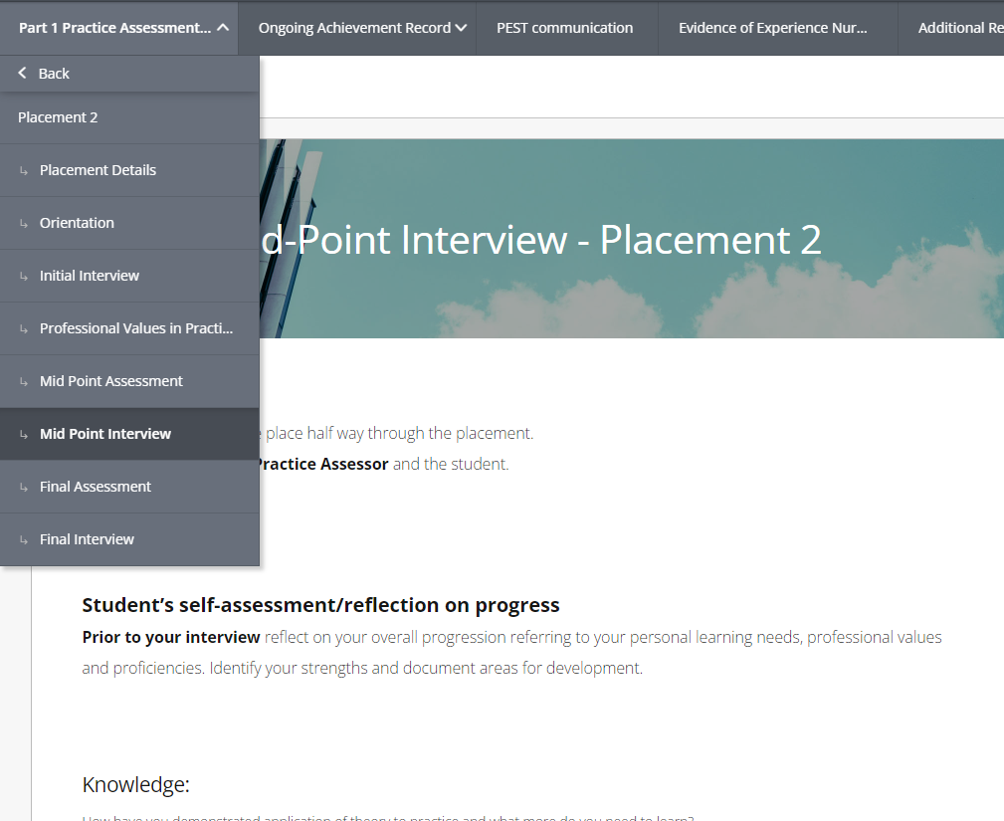
Mid-Point Interview
Students are expected to complete self-assessment text boxes and grid before meeting with the Practice Assessor
Scroll down the page and complete as necessary
Practice Assessor to add comments and complete grid
Practice Assessor to confirm either:
  The student is progressing
  The student is not progressing
An Action Plan must be formulated with the Practice Assessor if the student is failing to progress at this point.
Complete Learning and Development Needs
Check the following boxes:
  Student agrees to the learning and development needs
  Practice Assessor agrees to the learning and development needs

Slide 14
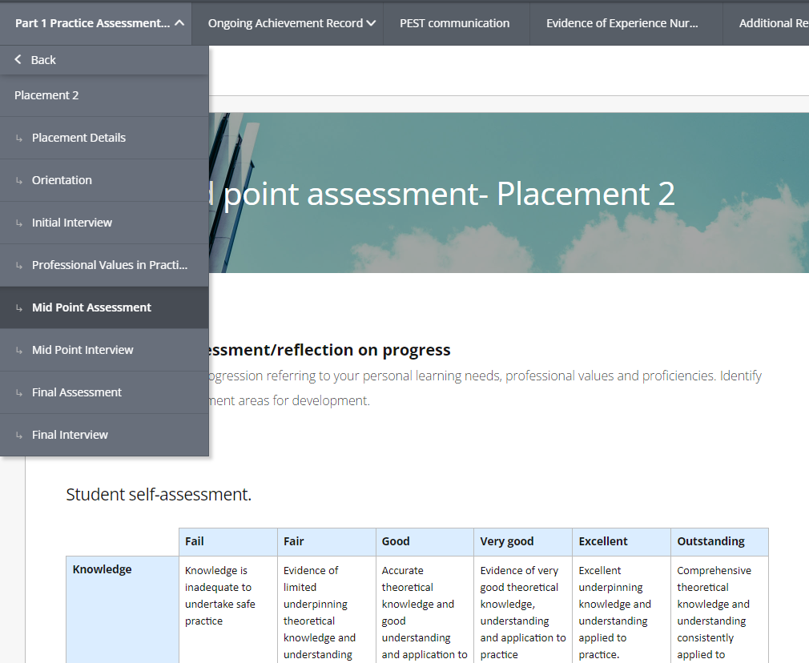
Mid-Point Assessment
Students are expected to complete self-assessment grid before meeting with Practice Assessor
Scroll down the page and complete as necessary
Practice Assessor to add comments and complete their grid

Slide 15
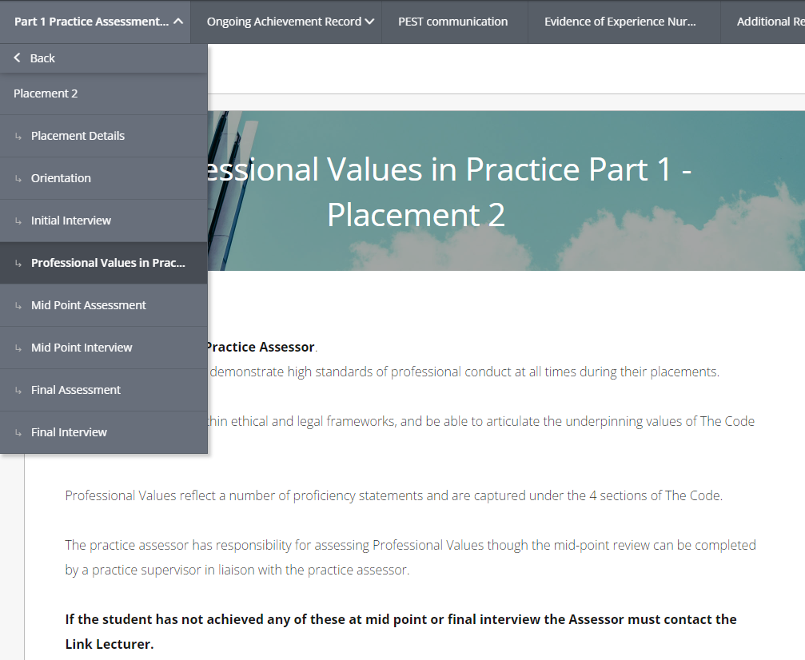
Professional Values
Select the Yes / No boxes as appropriate
Scroll down the page and complete as necessary
Professional Values to complete for both the Mid-Point and the Final assessment
Check the following box:
  Mid-Point assessment reviewed and agreed by practice assessor
Students must complete the End Point Student Reflection when completing the Final Assessment
Check the following box:
  Final assessment completed

Slide 16
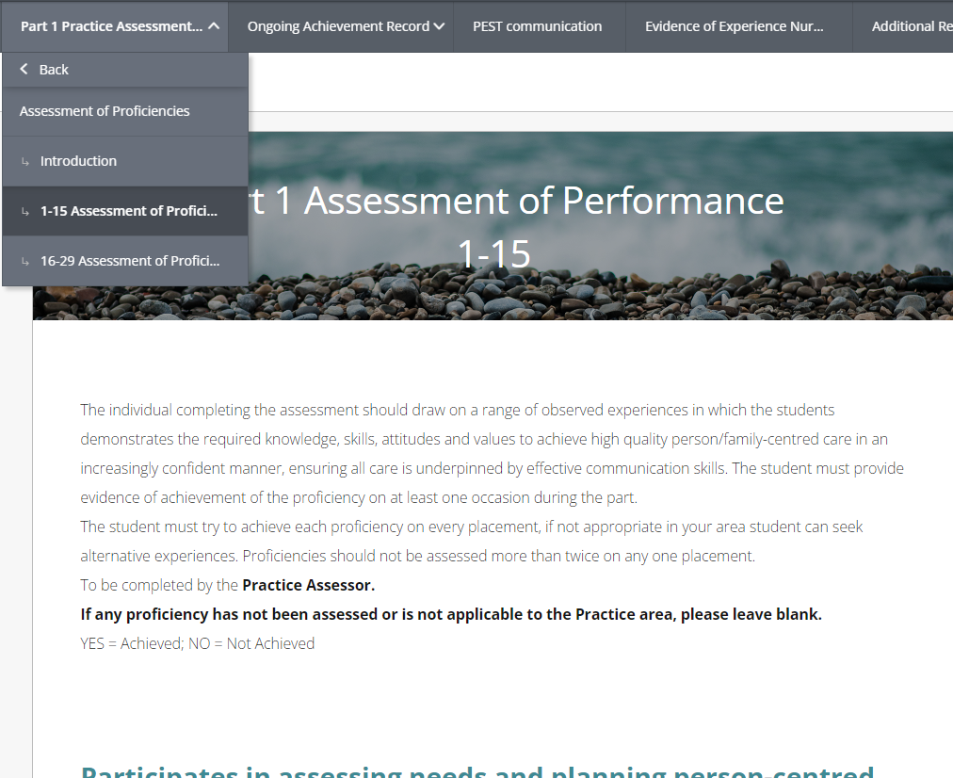
Assessment of Proficiencies
Select the Yes / No boxes as appropriate
Scroll down the page and complete as necessary
Proficiencies to complete are over two pages
Ideally, students should provide supporting evidence in the text box below each proficiency, however this is not mandatory
At least one of each proficiency must be completed by end of the Part / Year
Years 2 & 3 Proficiencies: Those with a * need to be completed by the end of the Part /Year

Slide 17
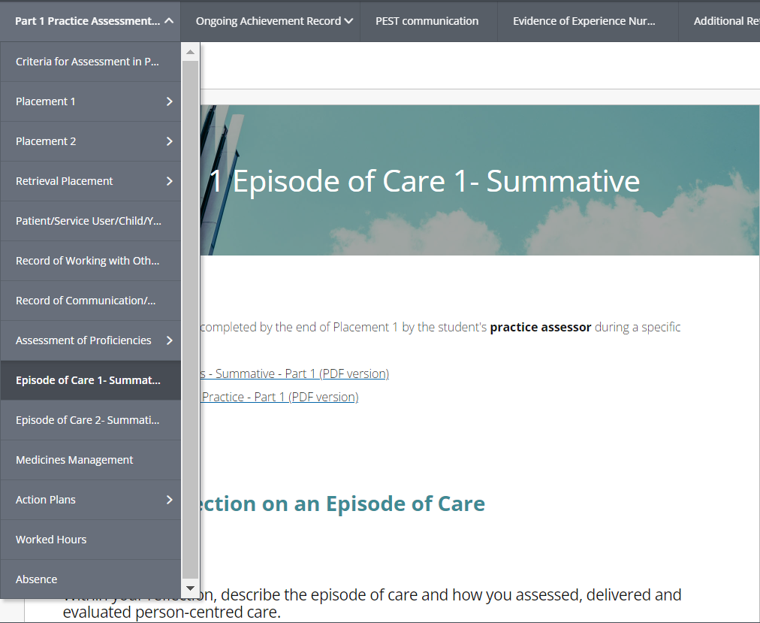
Episode of Care
Students are expected to complete the text boxes.
Word count is a recommended guide only; quality beats quantity
Scroll down the page and complete as necessary
Practice Assessor to provide written feedback in the text boxes and check Yes / No radio buttons as necessary
Check the following boxes:
  Student Verification
  Practice Assessor Verification

Slide 18
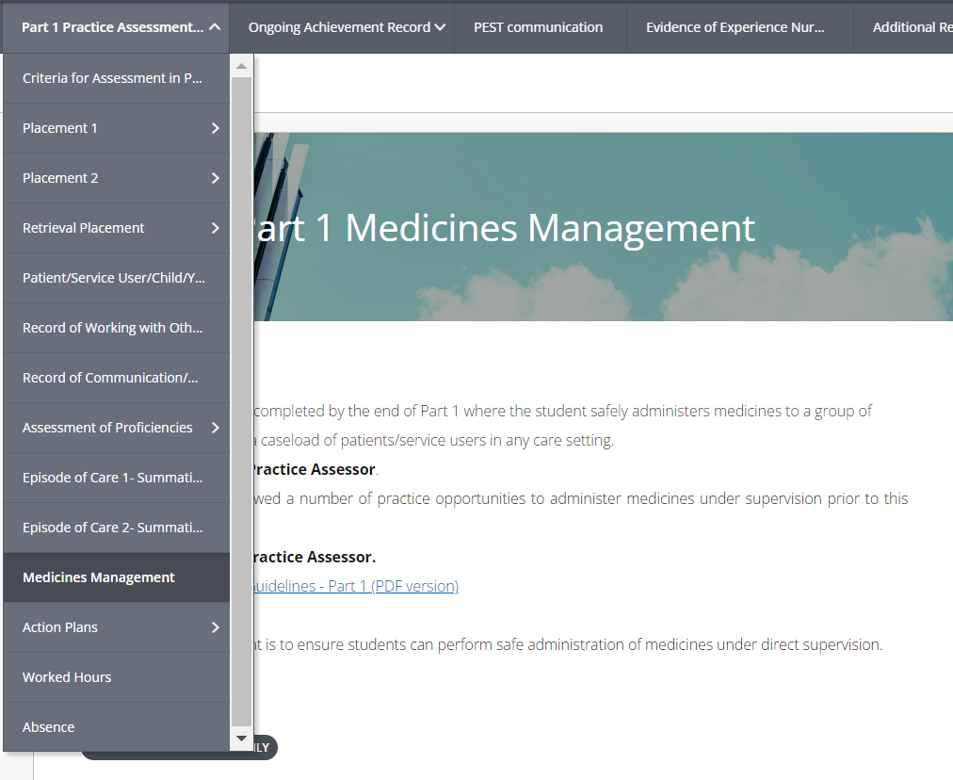
Medicines Management
Select the Yes / No boxes as appropriate
Scroll down the page and complete as necessary
Practice Assessor to provide written feedback in the text box
Students are expected to complete the Student Reflection
Check the following boxes:
  Student Verification
  Practice Assessor Verification
Must be completed by end of the Part / Year

Slide 19
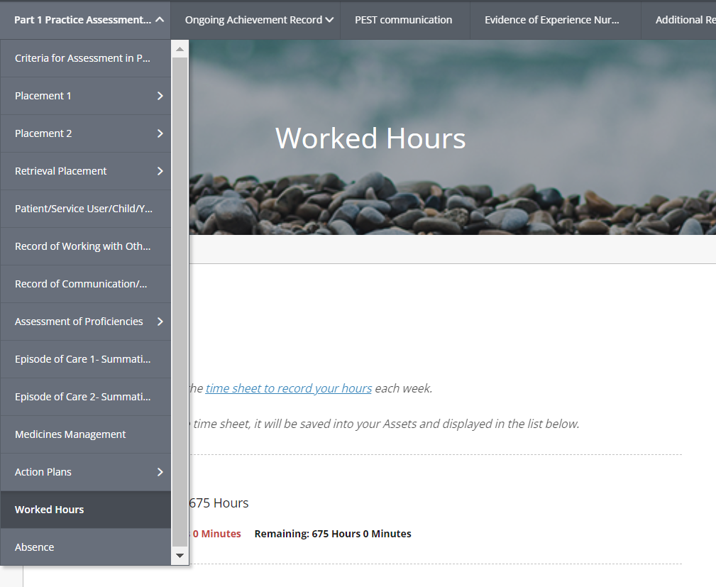
Worked Hours
Students are encouraged to complete every week to minimise risk of errors
Practice Supervisor or Assessor can verify student's hours
40 hours for Prep for Practice week and 8 hours for Reflective Forum are included in practice hours and can be verified by Practice Supervisor, Practice Assessor or Academic Assessor
Hours not verified by final submission will not be accounted for

Slide 20
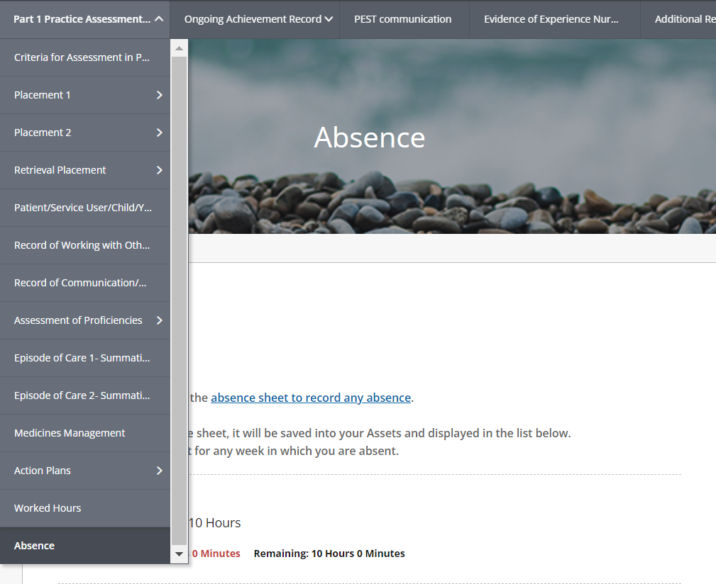
Absences
Students are encouraged to complete every week as necessary to minimise errors
Practice Assessor or Practice Supervisor can verify
Students must follow the prescribed absence policy and inform their Link Lecturer of any absences.

Slide 21
First Day of the Final Week
Final Interview
Elements to complete:
Final Assessment
Students should also be:
Reviewing all elements to ensure they are completed for submission
Ensuring timesheets are complete, accurate and verified, with any absences correctly documented

Slide 22
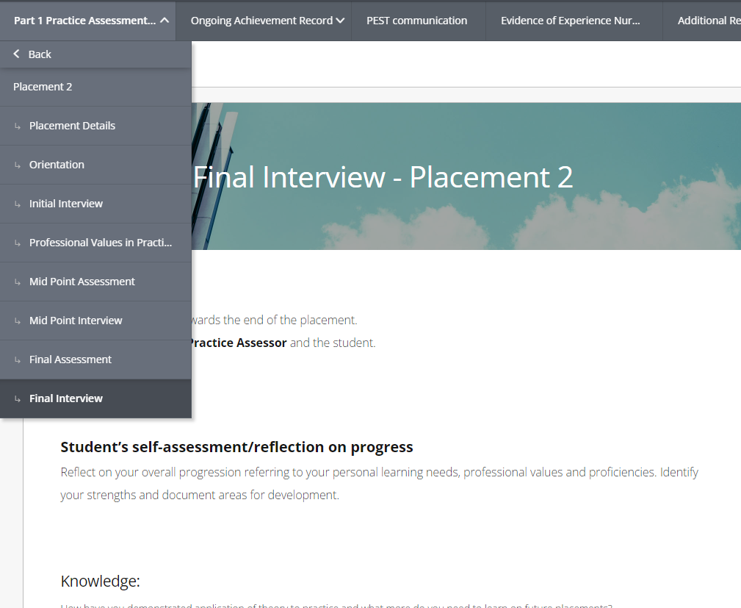
Final Interview
Students are expected to complete the text boxes prior to meeting with Practice Assessor
Scroll down the page and complete as necessary
Practice Assessor to complete their allocated text boxes during the interview
Check the following boxes as relevant:
  Was an Action Plan Required? (Yes or No)
  Checklist for assessed documents
  Student Verification
  Practice Assessor Verification
Practice Assessor to confirm either:
  The student is progressing
  The student is not progressing
Check the following boxes:
  Student agrees to the learning and development needs
  Practice Assessor agrees to the learning and development needs

Slide 23
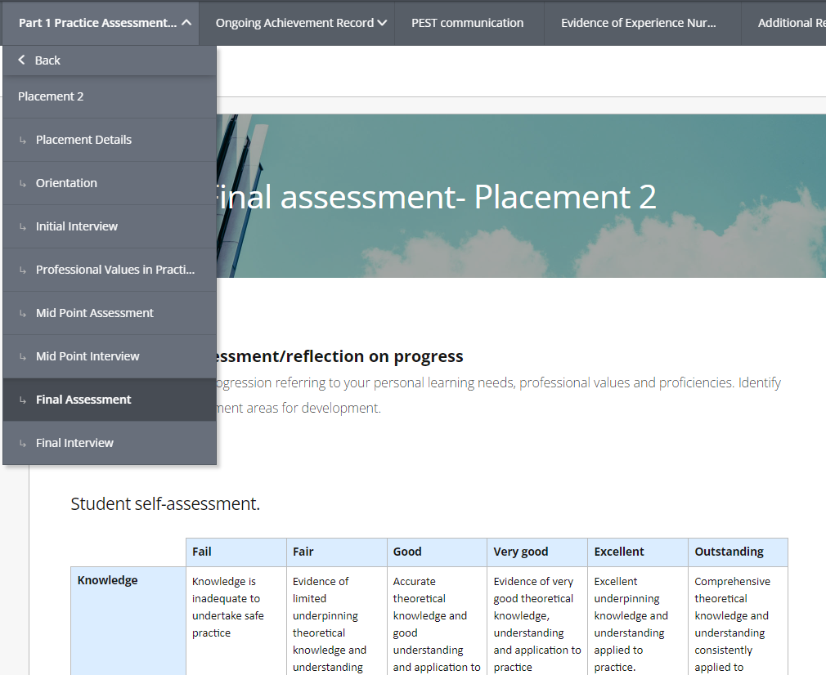
Final Assessment
Students are expected to complete self-assessment grid before meeting with Practice Assessor
Scroll down the page and complete as necessary
Practice Assessor to add comments and complete assessment grid
Remember to return to Professional Values to complete the End point Student Assessment and Reflection
Practice Assessor to check the following box:
  Final assessment completed

Slide 24
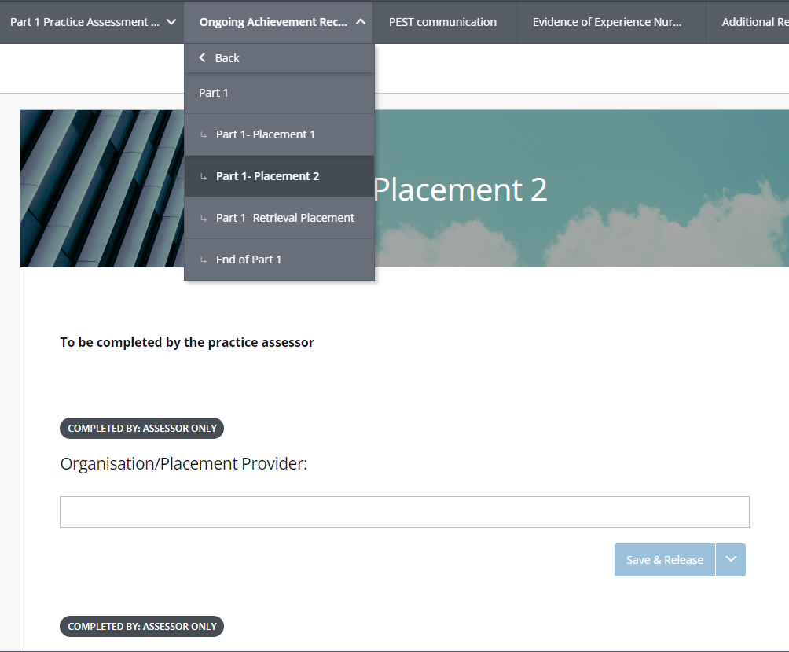
Ongoing Achievement Record (OAR) – Part x, Placement y
Practice Assessor to complete assessment, add comments and select Yes / No boxes as appropriate
Scroll down the page and complete as necessary
Allocated hours need to tally with the hours verified in your timesheets
Check the following boxes:
  Student Verification
  Practice Assessor Verification
The student’s PAT / Academic Assessor will leave feedback on this page when verifying the EPAD

Slide 25
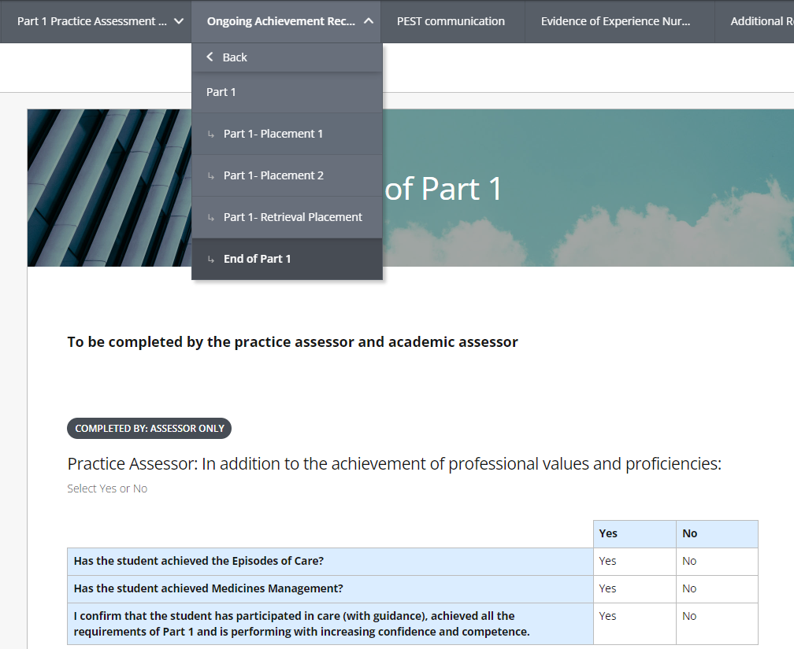
Ongoing Achievement Record (OAR) – Part x, End of Part y
Used on the second placement of the Part / Year
Practice Assessor to complete assessment, add comments and select Yes / No boxes as appropriate
Scroll down the page and complete as necessary
Check the following box:
  Practice Assessor Confirmation
Academic Assessor will use the relevant radio button to confirm student’s progression to the next Part / Year

Slide 26
Verification Process
Feedback and advice will be given of any incomplete documentation
Students are required to return completed EPADS for final submission within two weeks
Verification process begins:
Student submits EPAD for verification at end of Placement

Slide 27
Any Questions?

